Slide 1
DevSecOps

Slide 2



Agenda
Toyota Production System
Lean
0900
Value Streams
The Toyota Production System
Lean
Agile
DevSecOps
Break
1000
Practical Exercise
Break
1100
Quiz
Agile
DevSecOps

Slide 3
Value Streams
Toyota Production System
Lean
A value stream is the process required to convert a business hypothesis into a service or feature for a customer.
Examples
  Power, gas, and water utilities
  Internet access
  Laundry
  Food delivery
  3D printing
  Social media content
Agile
DevSecOps

Slide 4
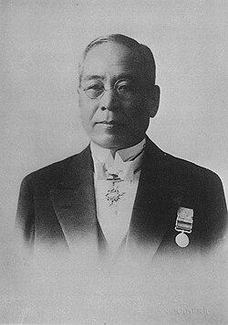
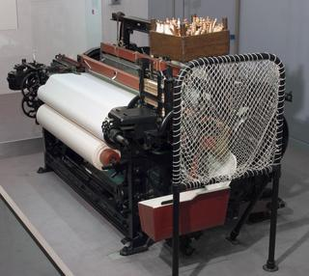
Toyota Production System
Toyota Production System
A production system based on the philosophy of achieving the complete elimination of waste in pursuit of the most efficient methods.
Making work easier for workers.
Lean
Agile
DevSecOps
Notes:
The Toyota Production System (TPS) originated from a man named Sakichi Toyoda in the 1920s.
Sakichi had a strong sense of public service and “doing things for others.”
One of the first people he wanted to help was his mom, who would sew all night using manual loom.
To help her, he invented an automatic loom.
What made it unique was it would stop if a sewing needle broke.
With a manual loom, the loom continues even if the needle is broken.
When this occurred, the downstream process would produce runs in the fabric stitches of the final product.
By eliminating both defective products and the associated wasteful practices, Sakichi succeeded in rapidly improving both productivity and work efficiency.
This is where the concept of jidoka was born.

Slide 5
Toyota Production System
Toyota Production System
Jidoka
Automation with a human touch
Just-In-Time
Making only what is needed, when it is needed, and in the amount needed
Fulfilling orders from customers as quickly as possible
Lean
Agile
DevSecOps
Notes:
Human is always in the loop

Slide 6
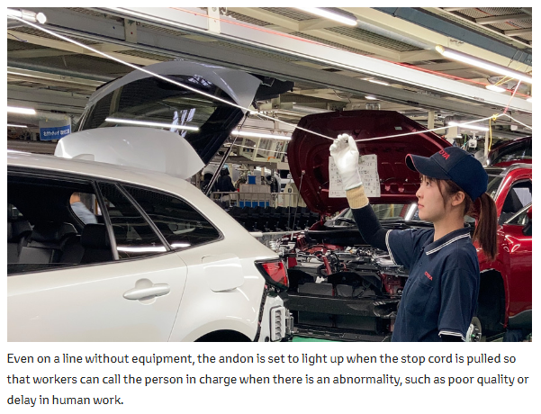
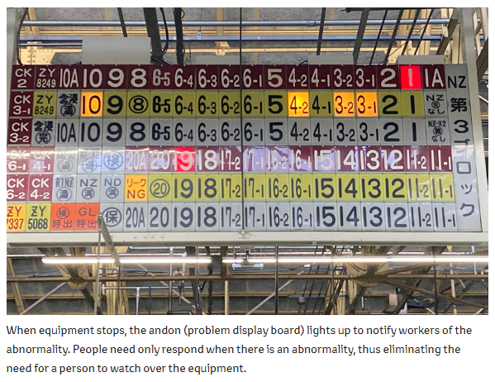
Toyota Production System
Toyota Production System
Lean
Agile
Notes:
The idea behind Jidoka is that by stopping the system you get an immediate opportunity for improvement

Slide 7
Toyota Production System
Toyota Production System
Lean
Agile
Notes:
The idea behind Jidoka is that by stopping the system you get an immediate opportunity for improvement
Another key take way is to “make work visible” so others can help surge on the problem (Lean introduces kanban boards)
Everyone should be working towards global goals

Slide 8
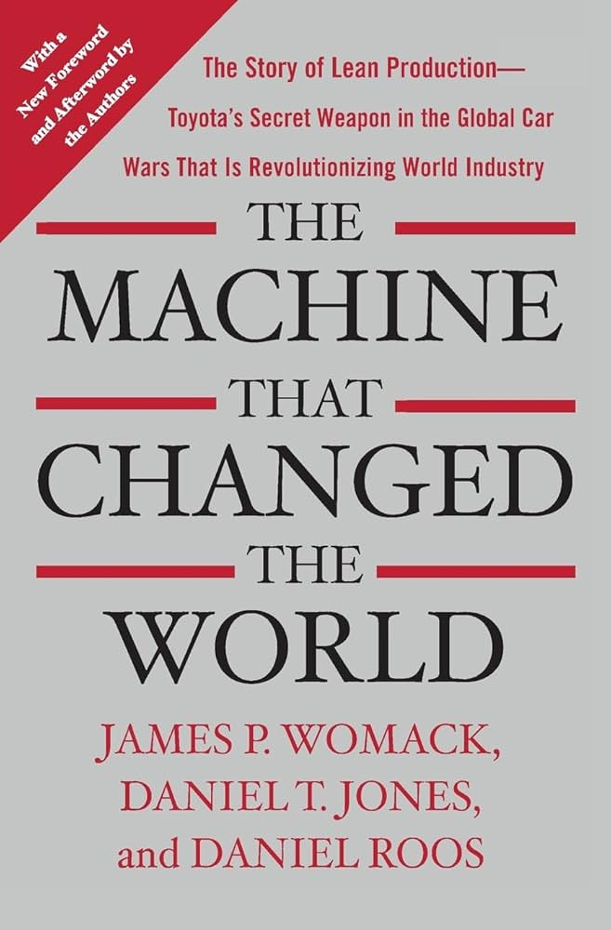
Lean
Toyota Production System
Lean
A management philosophy focused on maximizing value for the customer while minimizing waste.
Agile
Notes:
1st Waste: Partial work
Problem
Sign up to do something
Waiting around to finish that something
There comes a point where you’re spending more time managing projects than making progress on them
Solution
Identify what your “buckets” and how much they can handle and then enforce that
2nd Waste: Transportation
Problem
Solution
Be diligent in your communication
Follow a protocol that improves quality and reduces quantity of DMs
Reference: Hamster Revolution
3rd Waste: Movement (looking for stuff)
Problem
Solution
Sort by COTA (Customers, Outputs, Teams, Admin)
4th Waste: Waiting
Problem
Solution
Spend that time thinking
Reorganize
Surge
5th Waste: Defects
Problem
Solution
Use checklists
6th Waste: Overprocessing
Problem
Doing more than what the customer wants
Multi-tasking (maker vs manager schedule)
Solution:
7th Waste: Overproduction
Problem
Knowledge too early (it expires before it can be applied)
Solution:

Slide 9
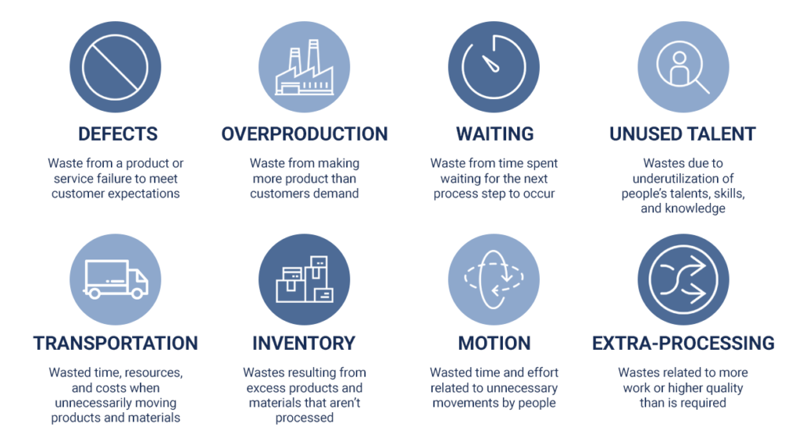
Lean
Notes:
1st Waste: Partial work
Problem
Sign up to do something
Waiting around to finish that something
There comes a point where you’re spending more time managing projects than making progress on them
Solution
Identify what your “buckets” and how much they can handle and then enforce that
2nd Waste: Transportation
Problem
Solution
Be diligent in your communication
Follow a protocol that improves quality and reduces quantity of DMs
Reference: Hamster Revolution
3rd Waste: Movement (looking for stuff)
Problem
Solution
Sort by COTA (Customers, Outputs, Teams, Admin)
4th Waste: Waiting
Problem
Solution
Spend that time thinking
Reorganize
Surge
5th Waste: Defects
Problem
Solution
Use checklists
6th Waste: Overprocessing
Problem
Doing more than what the customer wants
Multi-tasking (maker vs manager schedule)
Solution:
7th Waste: Overproduction
Problem
Knowledge too early (it expires before it can be applied)
Solution:

Slide 10
Lean
Toyota Production System
Lean
Define Value
Focus on what solves the problem.
Map the Value Stream
Make work visible using a Kanban board.
Create a Flow
Keep batches of work small to avoid blockers.
Establish Pull
Only eat when you’re hungry.
Agile

Slide 11
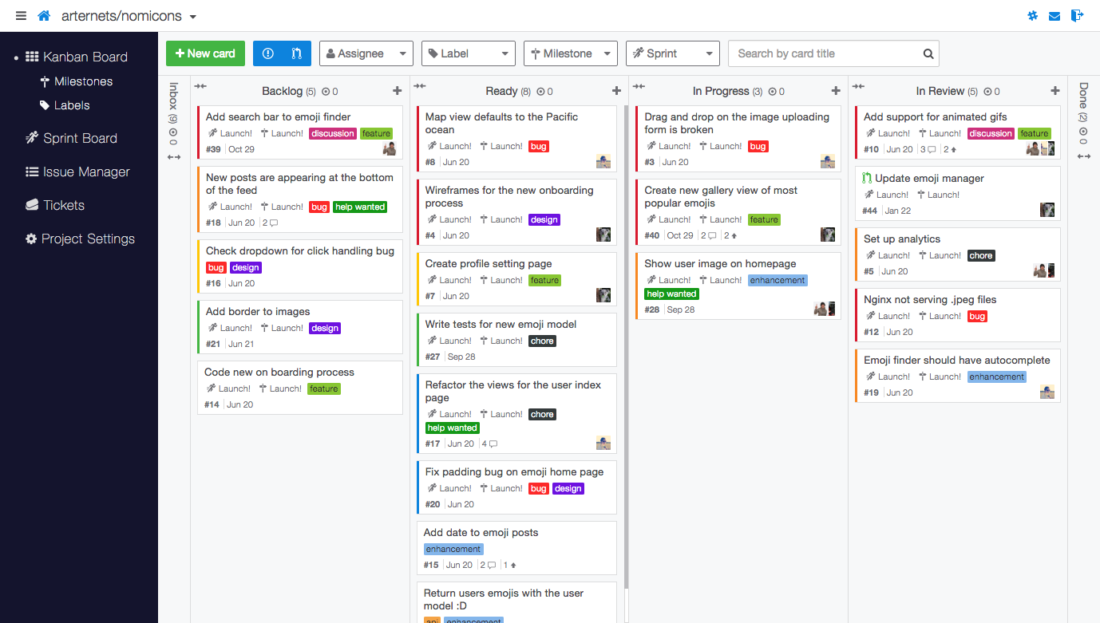
Lean
5/10
8/10
3/2
5/10
How many pieces of work can our value stream handle before one of our work centers are overwhelmed?

Slide 12
Agile
A software development methodology focused on delivering value to the customer rapidly.
Individuals and interactions over processes and tools
Working software over comprehensive documentation
Customer collaboration over contract negotiation
Responding to change over following a plan
Toyota Production System
Lean
Agile

Slide 13
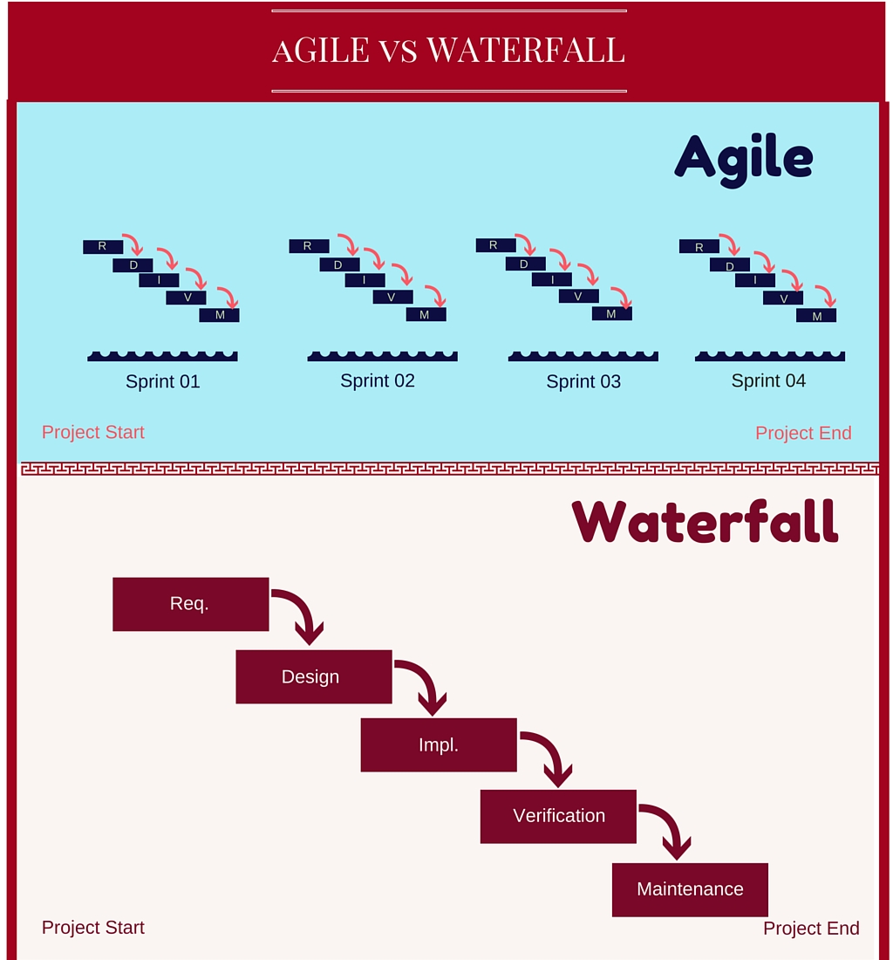
Agile
Agile Methodology
Waterfall Methodology

Slide 14
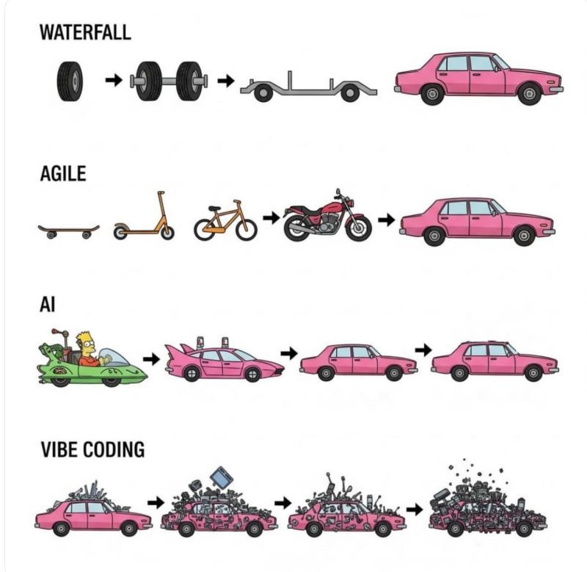

Slide 15
DevSecOps
DevSecOps is the result of applying principles from physical manufacturing and leadership domains to your software development value stream.
Making work easier for the workers
Maximizing value while minimizing waste
Delivering value to the customer rapidly
Toyota Production System
Lean
Agile

Slide 16
DevSecOps
The First Way the principles of flow | Keep your batches of work small, visible, and based on global goals for faster processing, shorter wait times, and more innovation.
Continuous Test Continuous Build Continuous Integration Continuous Delivery Continuous Deployment
The Second Way the principles of feedback | Shorten the feedback loop between you and your deployment environment to reduce the time detect/recover of problems. Amplify feedback as it’s received.
Continuous Monitoring
The Third Way the principles of continuous learning and experimentation | Promote a high-trust culture that supports a dynamic, disciplined, and scientific approach to experimentation to innovate faster.
Continuous Improvement

Slide 17
References
Toyota Production System
https://global.toyota/en/company/vision-and-philosophy/production-system/
“Lean Applied to Us” by Bill Peterson at TEDxKnoxville
https://youtu.be/tfQiGDUBdD0?si=rPpgv_lnBAJB0LKt
Agile Manifesto
https://agilemanifesto.org/
DevOps Handbook
https://itrevolution.com/product/the-devops-handbook-second-edition/

Slide 18
ARTIFICIAL INTELLIGENCE INTEGRATION CENTER
CW3 Vic Fernandez III
victor.fernandez19.mil@army.mil
Break

Slide 19
Practical Exercise
Setup
Break up into teams (e.g., by table).
Your Team Lead will be anyone who meets two of the following requirements:
Contributed to an open-source project
Believes in aliens
Likes early 2000s post-hardcore music
Loves (not like) pizza
Ensure the Team Lead creates a code repository in GitHub and shares access with everyone on the team.
Toyota Production System
Lean
Agile

Slide 20
Practical Exercise
Scenario
Your team has been tasked to create an app that boosts morale. The customer has not identified where they want the app to be deployed yet, but your Portfolio Lead wants you to ensure the app is ready when they do. To meet your Portfolio Lead’s intent, your app must be containerized and tested. It must also be reviewed and approved by your Team Lead.
Toyota Production System
Lean
Agile

Slide 21
Practical Exercise
Task
Create and containerize a morale-boosting app that has been reviewed and approved internally by someone else on your team.
Conditions
You have one hour to complete this task using the provided instructions.
You have access to a GitHub.
You are authorized to use whatever code editor you want.
Toyota Production System
Lean
Agile

Slide 22
Practical Exercise
Standard
You have met the standard of this task once you have created and containerized a morale-boosting app that has been reviewed and approved internally by someone else on your team.
Toyota Production System
Lean
Agile

Slide 23
Practical Exercise
Instructions
Do coding kata 1.
https://github.com/afc-ai2c/coding-katas/
Start
1000
End
1100

Slide 24
Quiz
What is are some examples of a value stream?
Physical manufacturing, food delivery, and software development.
What are some examples of implementing the first principle of DevSecOps?
Continuous Build, Test, Integration, Delivery, and Deployment.
What is are some examples of implementing the second principle of DevSecOps?
Continuous Monitoring (baking observability into an app).
What is are some examples of implementing the third principle of DevSecOps?
Continuous Improvement (sprint retrospectives).

Slide 25
ARTIFICIAL INTELLIGENCE INTEGRATION CENTER
CW3 Vic Fernandez III
victor.fernandez19.mil@army.mil
Questions?

